Slide 1
Triangulation Panel
21 Sept 2021
Attendees: Debbie Lawlor, Kate Tilling, Julian Higgins, Yoav Ben-Shlomo, Liz Coulthard, George Davey-Smith, Luke McGuinness

Slide 2
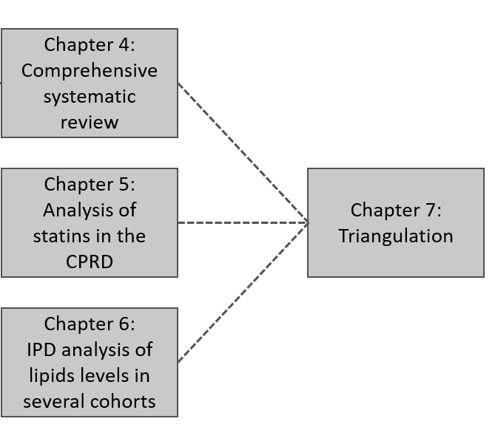
Summary of evidence sources
Three elements
Comprehensive systematic review (search conducted in July 2019)
Analysis of statin use in CPRD participants
Analysis of lipids levels across three previously unanalysed cohorts, obtained via the Dementia Platform UK

Slide 3
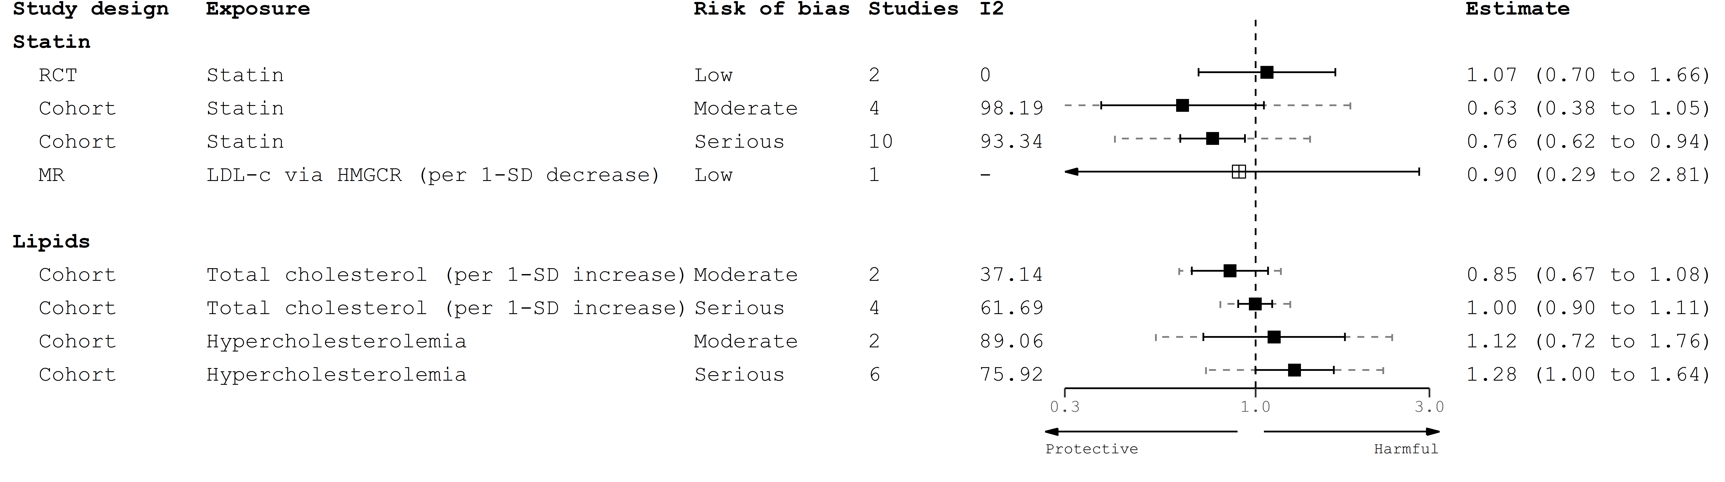
All – cause dementia
Study design | Common sources of bias
Cohort - Statins (NRSI) | Insufficient adjustment for/low validity of confounders; Immortal time bias; Missing outcome data; Non-differential misclassification of outcome
Cohort – Lipids (NRSE) | Insufficient adjustment for/low validity of confounders; Missing outcome data; Non-differential misclassification of outcome; Selection of the reported result (key example is different methods of categorizing lipid levels)

Slide 4
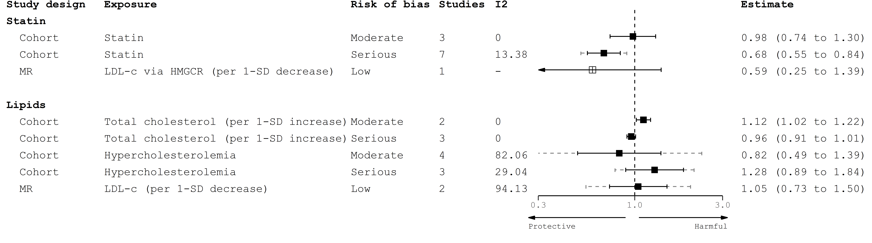
Alzheimer’s Disease
Study design | Common sources of bias
Cohort - Statins (NRSI) | Insufficient adjustment for/low validity of confounders; Immortal time bias; Missing outcome data; Non-differential misclassification of outcome
Cohort – Lipids (NRSE) | Insufficient adjustment for/low validity of confounders; Missing outcome data; Non-differential misclassification of outcome; Selection of the reported result (key example is different methods of categorizing lipid levels)

Slide 5
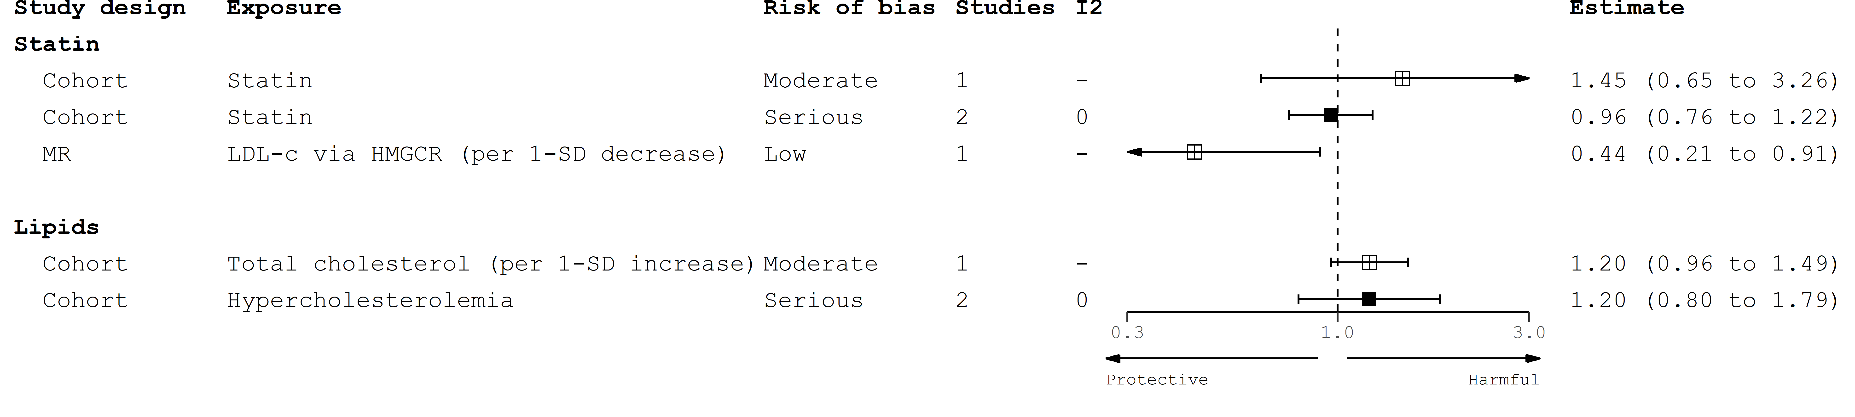
Vascular dementia
Study design | Common sources of bias
Cohort - Statins (NRSI) | Insufficient adjustment for/low validity of confounders; Immortal time bias; Missing outcome data; Non-differential misclassification of outcome
Cohort – Lipids (NRSE) | Insufficient adjustment for/low validity of confounders; Missing outcome data; Non-differential misclassification of outcome; Selection of the reported result (key example is different methods of categorizing lipid levels)

Slide 6
Discussion points
Options for combining presented results beyond a qualitative summary
Competing sources of bias within a single result (e.g. immortal time bias vs misclassification expected to bias result in different directions)
Incorporating different lipid categorisation (hypercholesterolemia vs per 1-SD increase)
Incorporating heterogeneity within a given evidence strata (e.g. statin-dementia cohorts had substantial heterogeneity)
Handling missing evidence within each synthesis
Presentation of results of triangulation

